Slide 1

ASUNDER

Slide 2

HOW DEEP IS YOUR LOVE?
Self-acceptance
Past regrets
Reassembly

Slide 3





BASICS
Notes:
Hand over to Lars

Slide 4


TARGET AUDIENCE
25 – 35
Mid-core
All genders
Limited leisure time
Mental phenomena
Implicit storytelling
Notes:
Hand over to Lars

Slide 5

PRODUCTION PLAN
09/06/19
Final concept
23/06/19
Vertical slice of first level
07/07/19
Basic versions of other levels
16/07/19
Polish
Notes:
Hand over to Lars

Slide 6

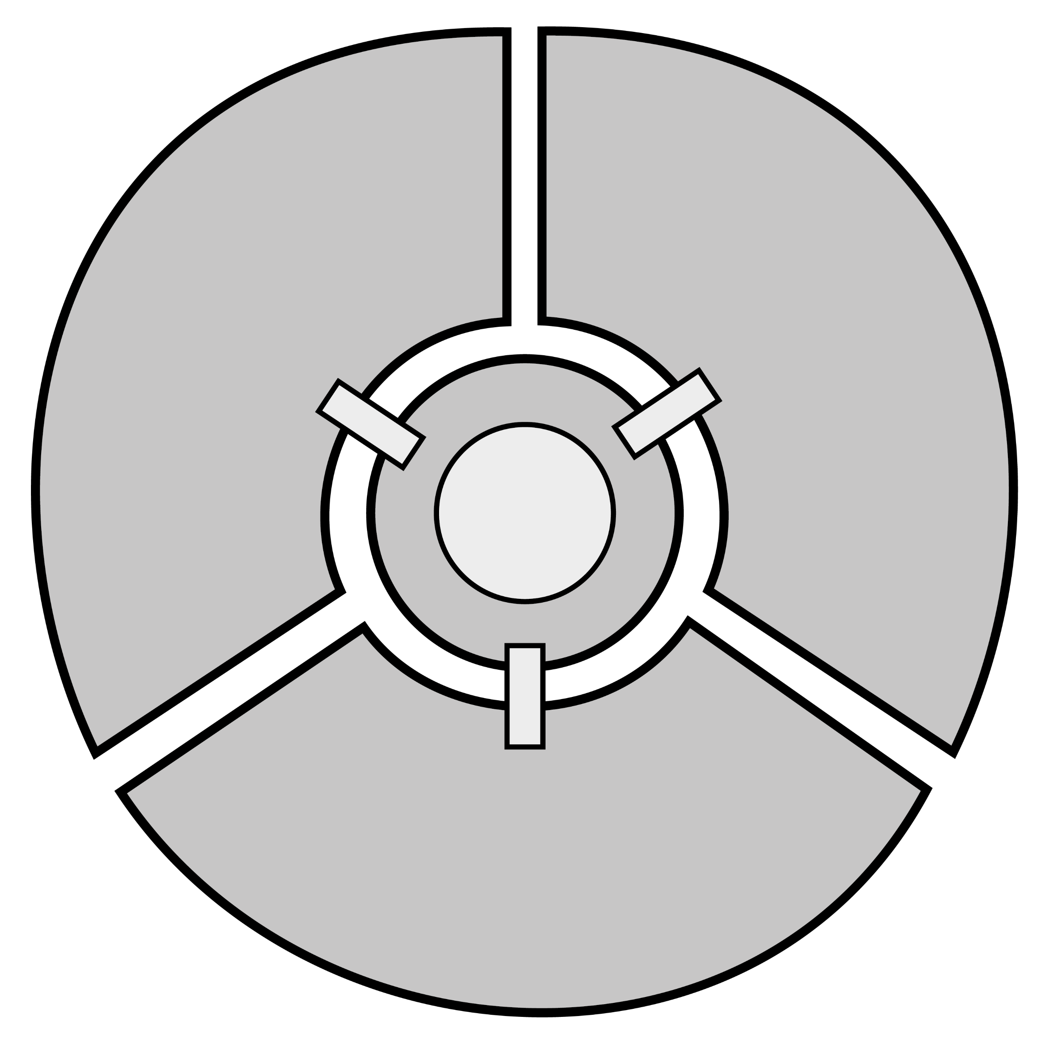
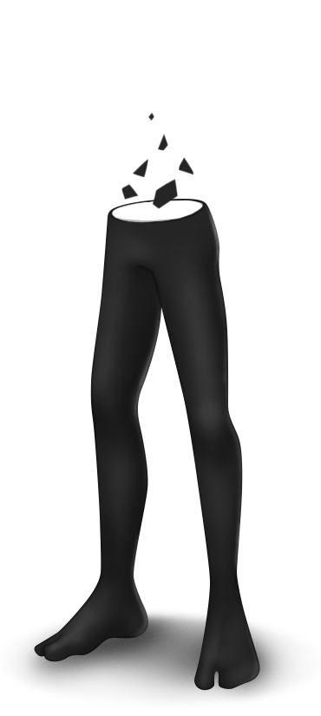

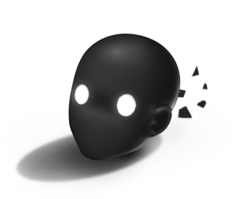
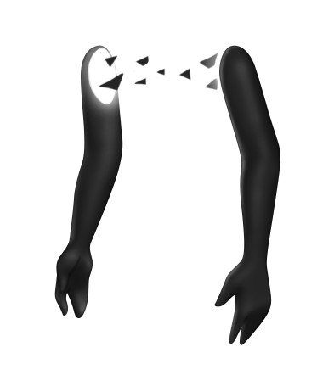
STRUCTURE
1
2
3

Slide 7


GAMEPLAY
Enter
Unlock
Analyze
Solve

Slide 8
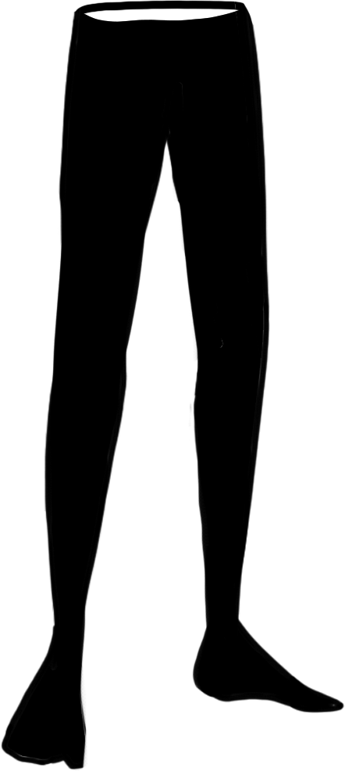


GAMEPLAY
Wall run
Push objects
Hook
Notes:
Hand over to Daniel

Slide 9



NARRATIVE
Environmental
storytelling
No conversation
Short stories

Slide 10

NARRATIVE
Running
away
Cowardice
Notes:
Hand over to Thiago

Slide 11




TECHNICAL APPROACH
Decoupled systems
Technical debt
Notes:
Hand over to Trix

Slide 12
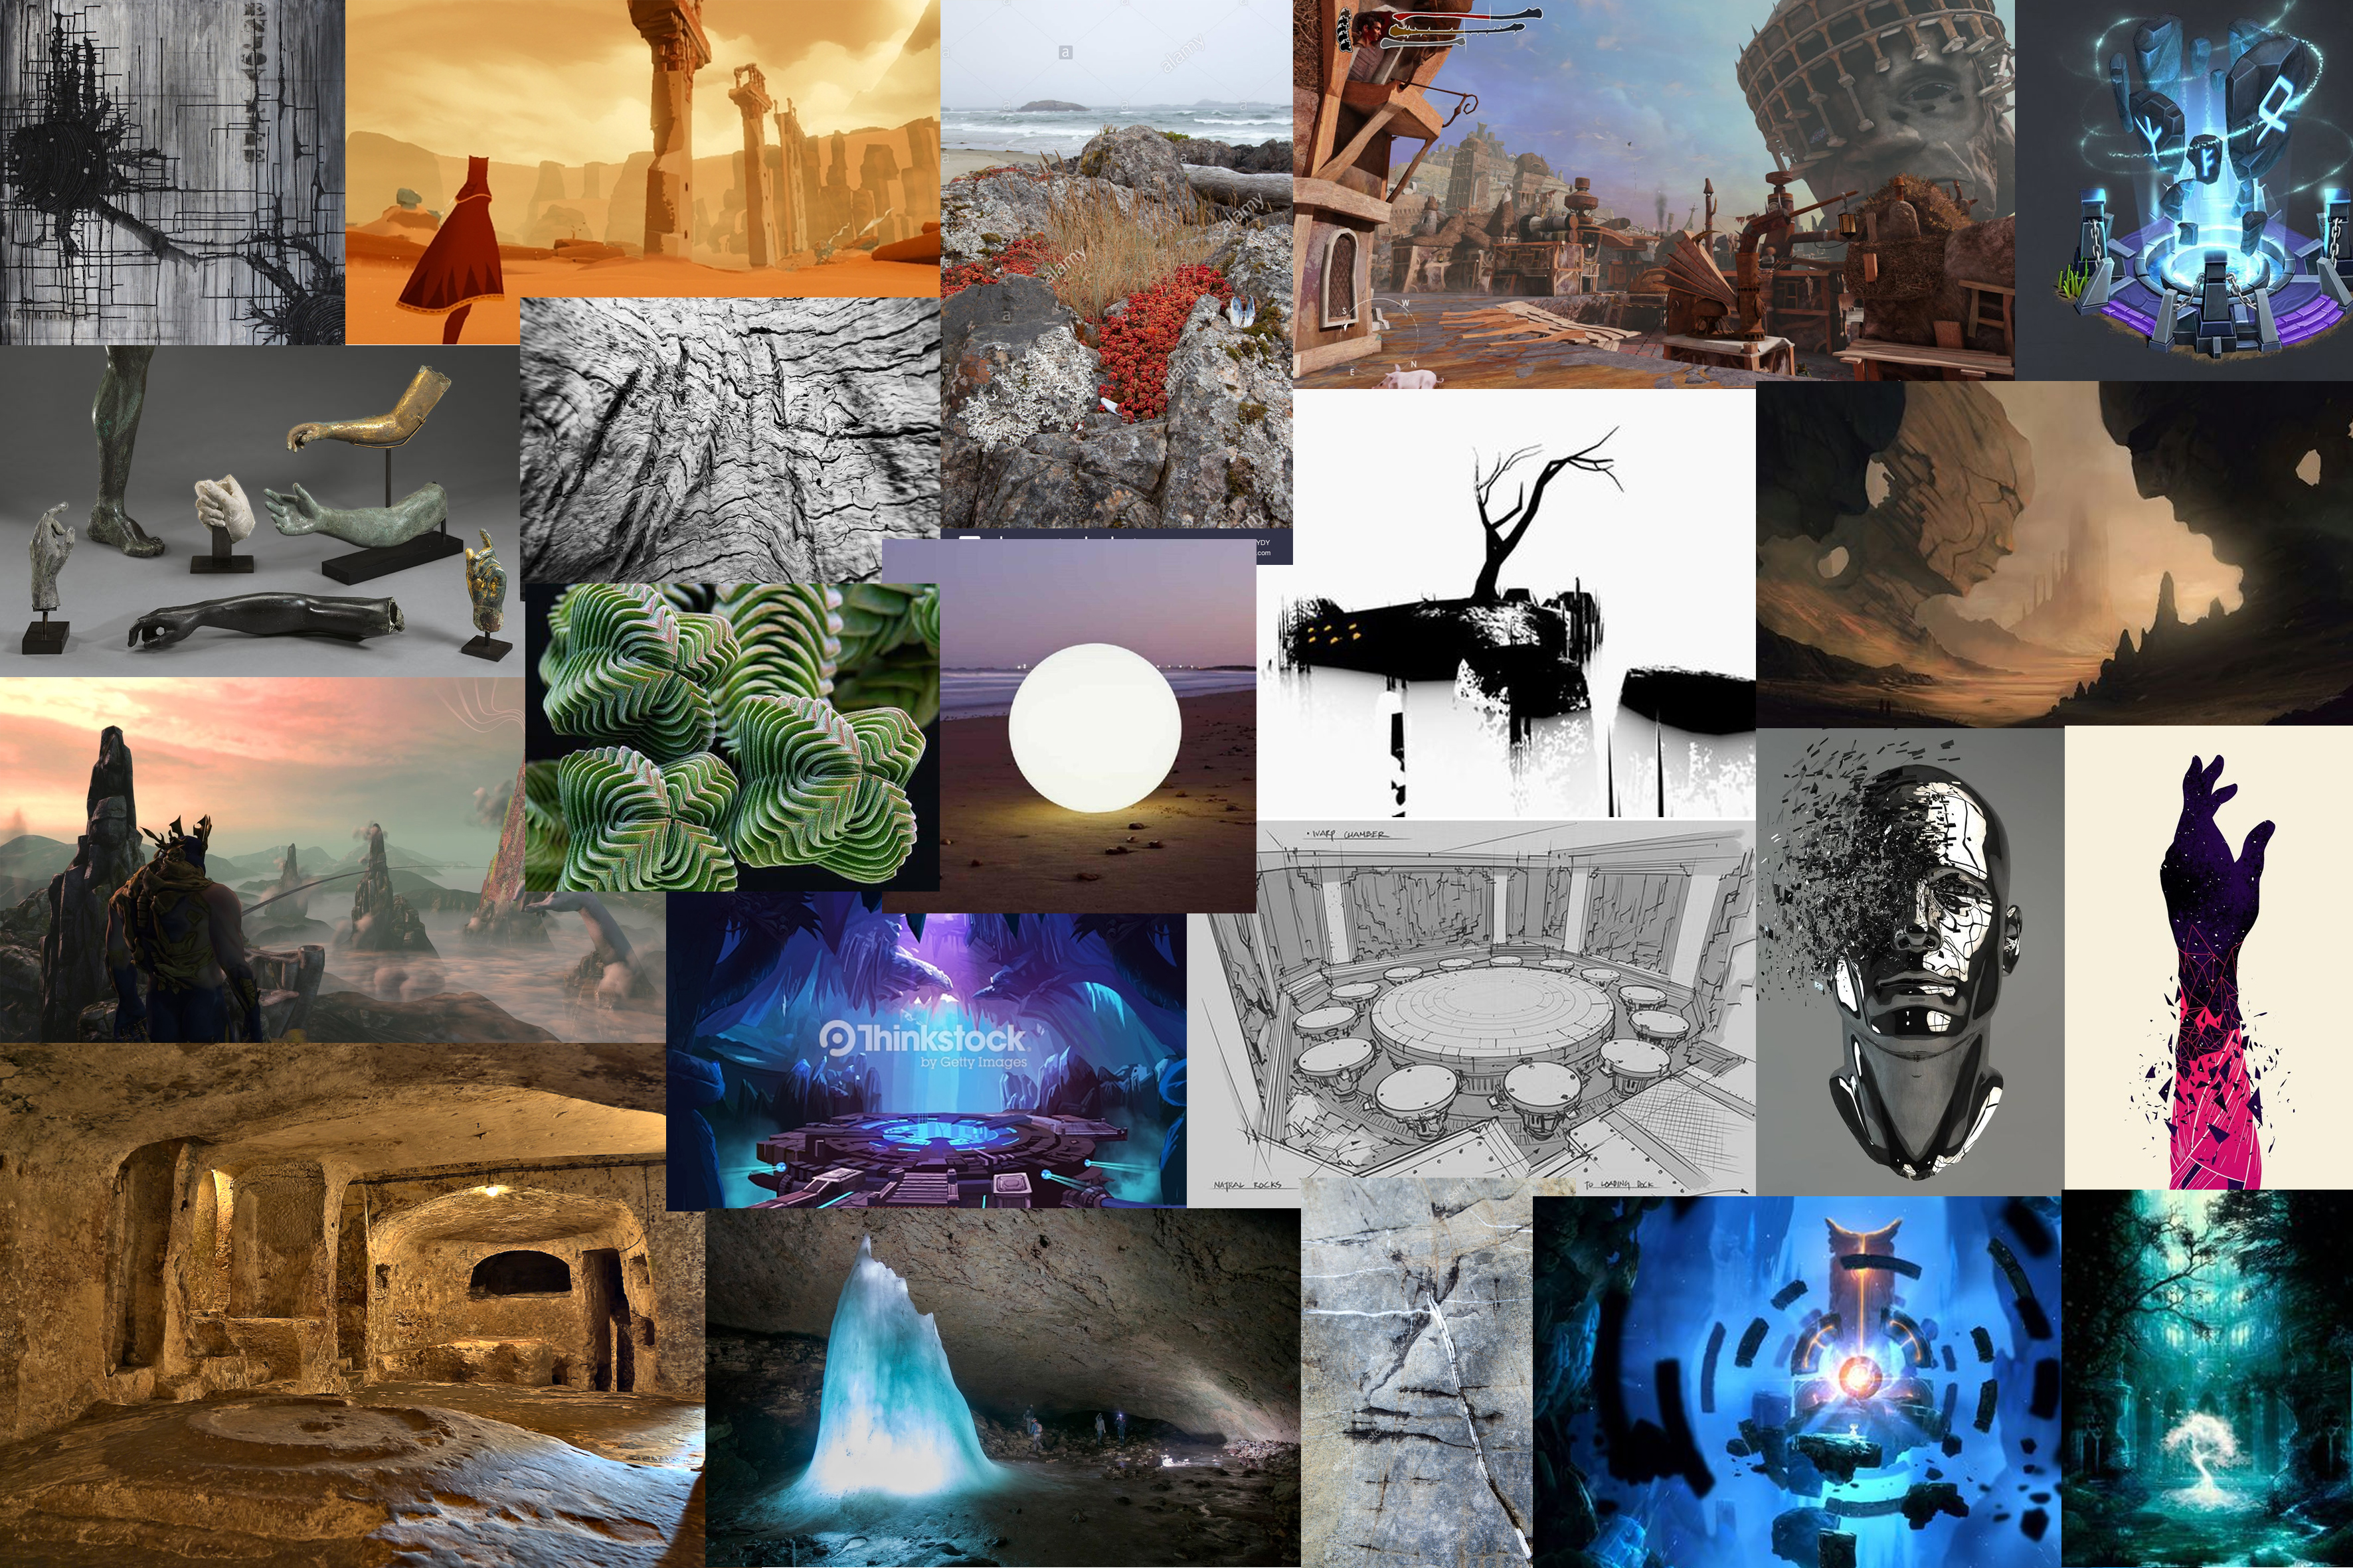

Slide 13
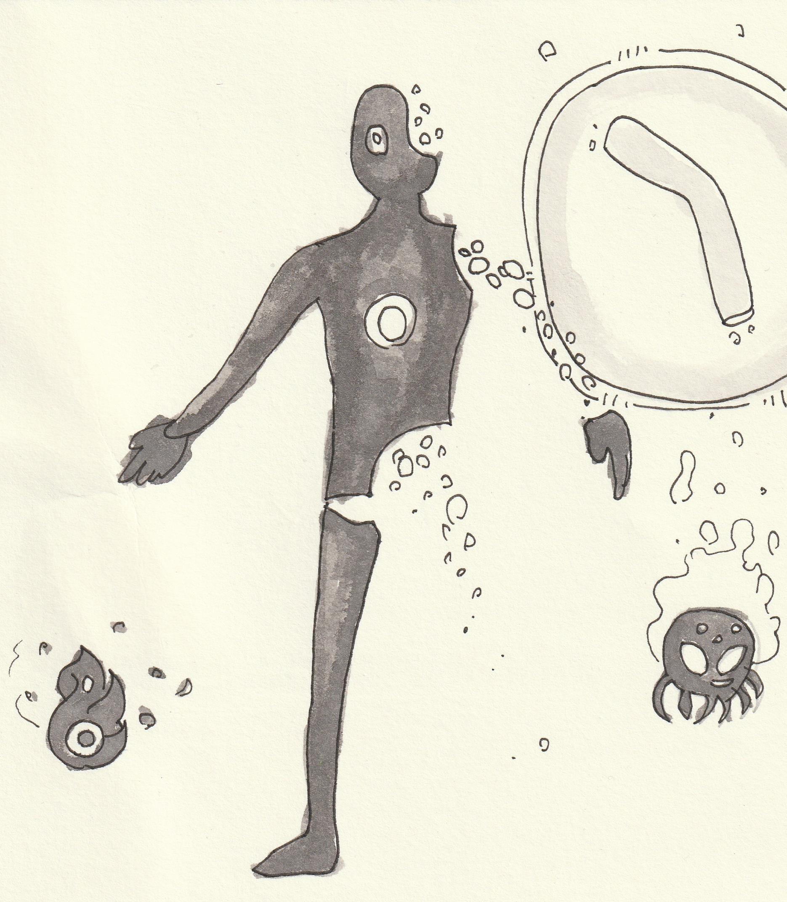
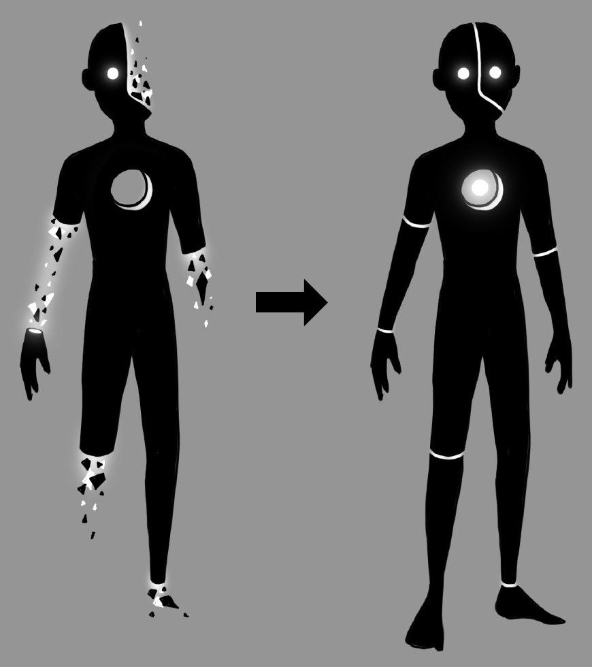
Art
Notes:
Hand over to Alex

Slide 14
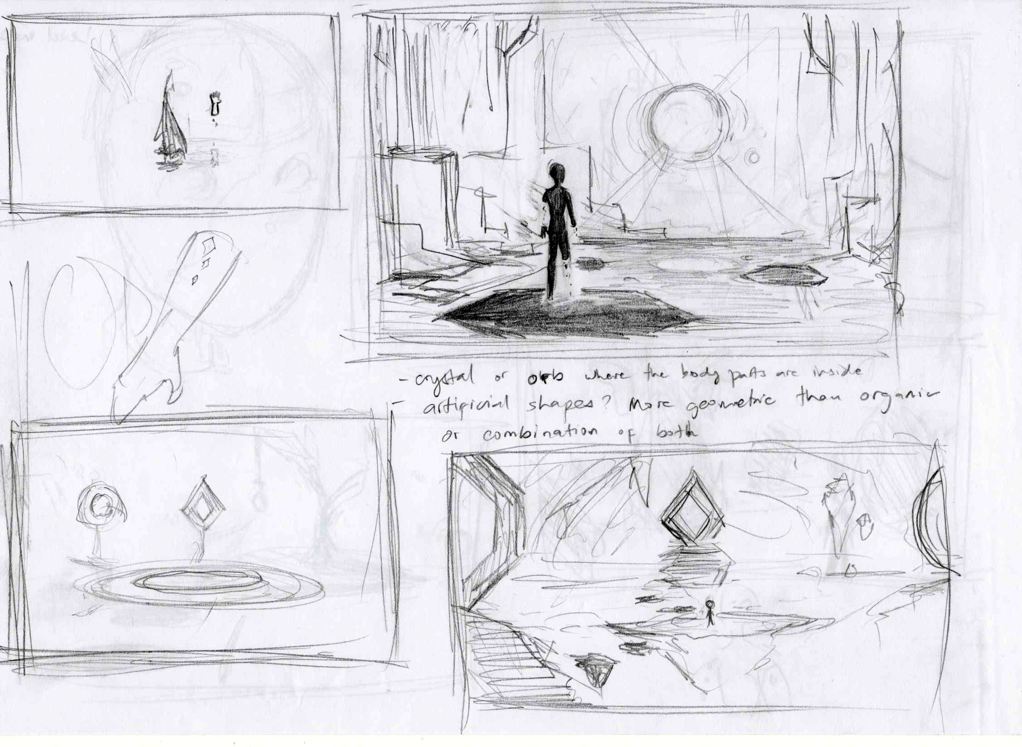
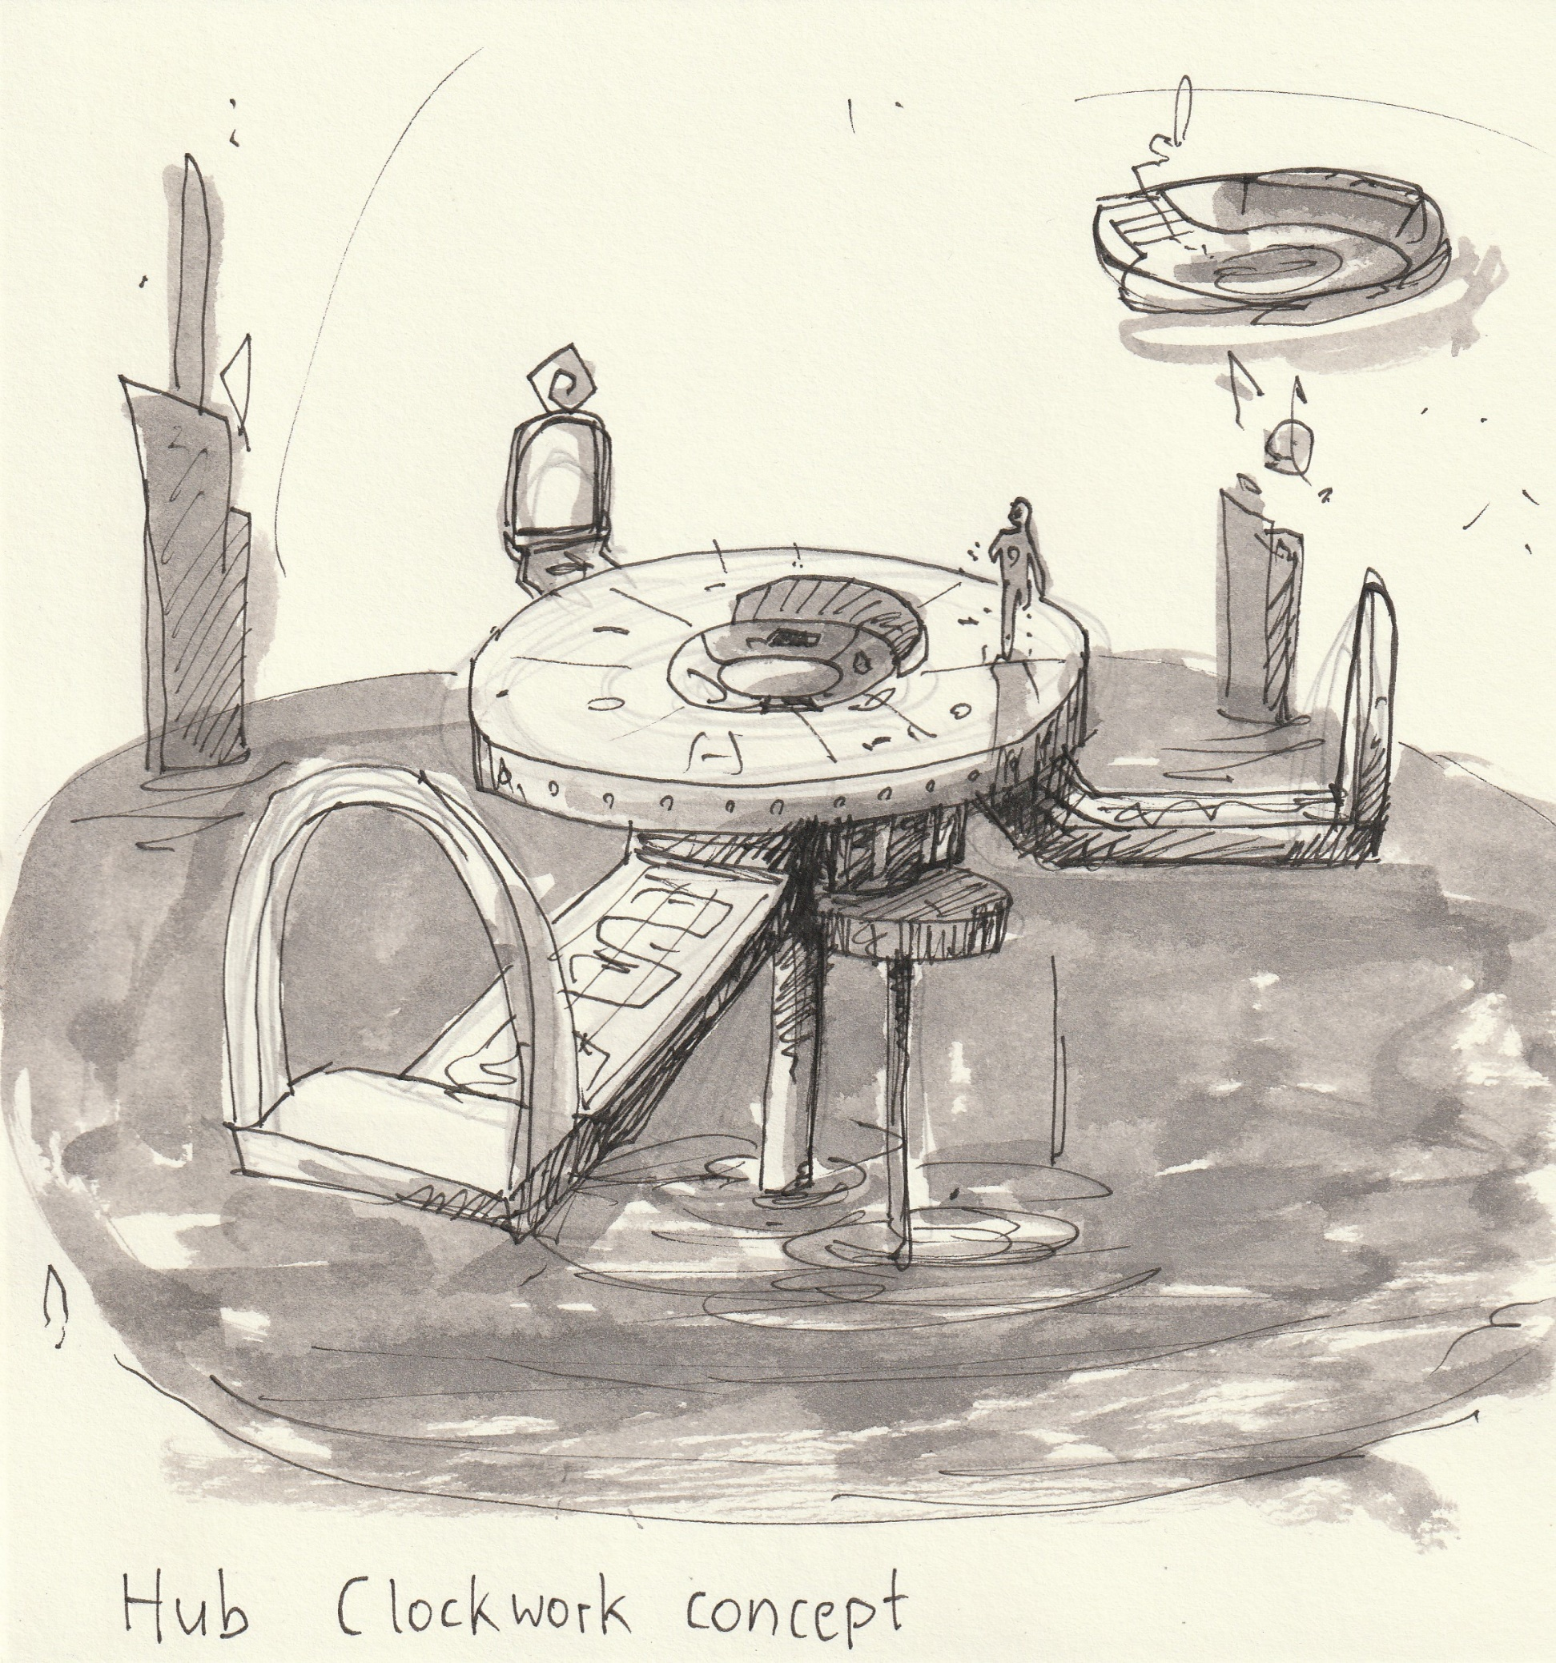
Art

Slide 15
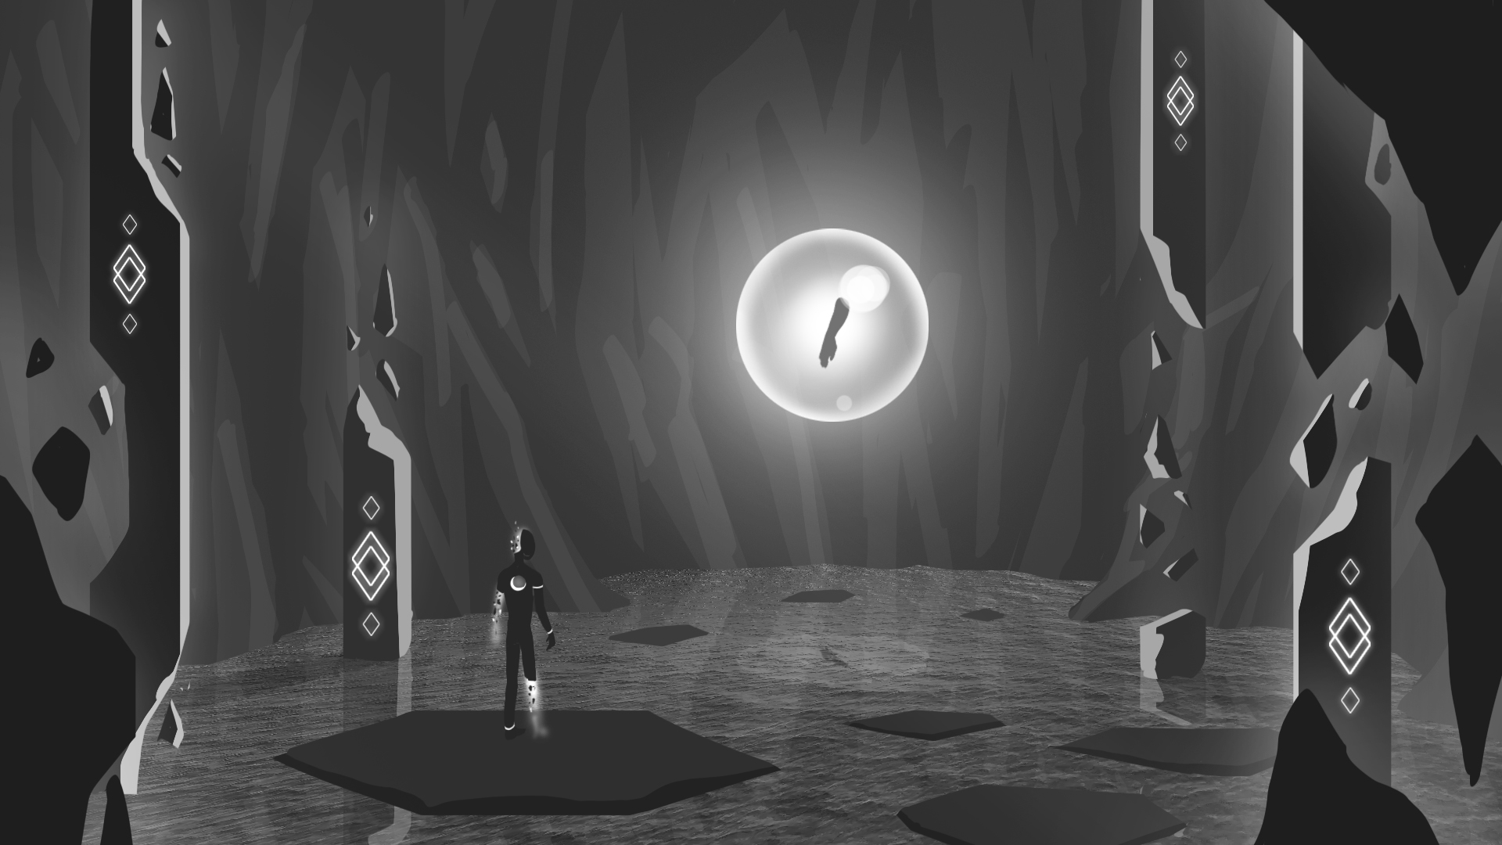

Slide 16
RIPOMATIC

Slide 17

THANK YOU!
Alexander Gerhards
Lead / Artist
Lars Kalthoff
Designer
Trixia Quinzon
Artist
Daniel Baracotti
Designer / Sound
Thiago Morano Gerding
Programmer

